Slide 1

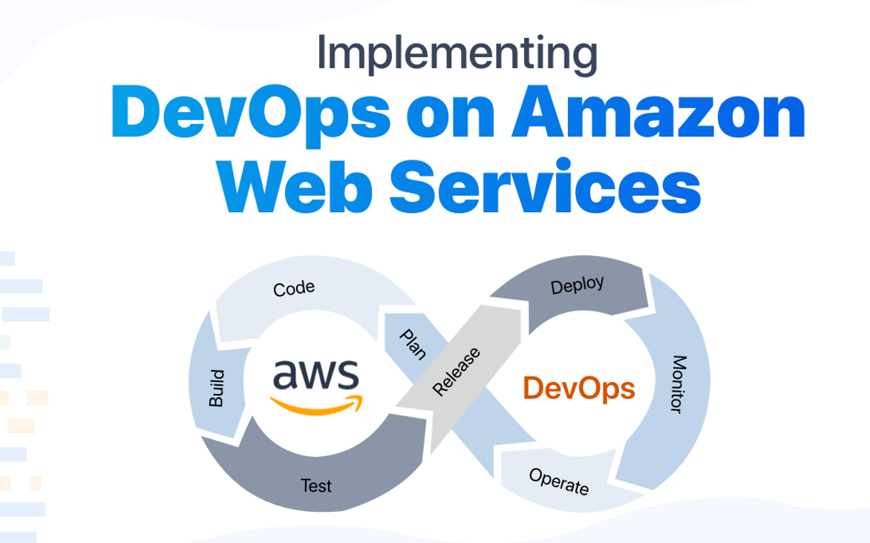
BY NAVEEN UPPALA

Slide 2
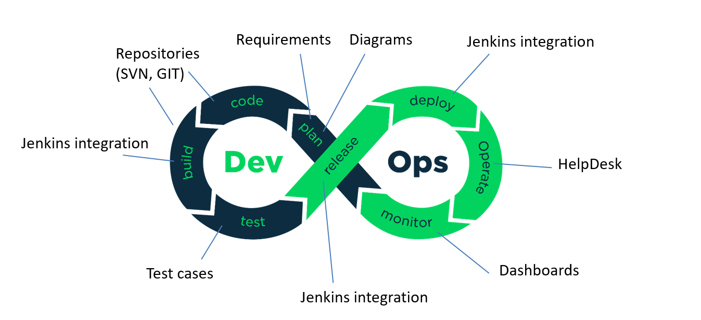
DevOps is the combination of cultural philosophies, practices, and tools that increases an organization’s ability to deliver applications and services at high velocity: evolving and improving products at a faster pace than organizations using traditional software development and infrastructure management processes.

Slide 3
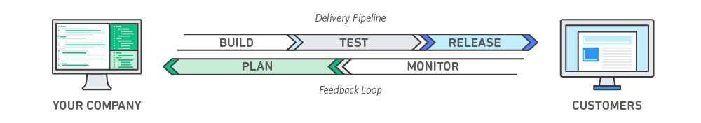
Benefits of Devops
Speed: Move at high velocity so you can innovate for customers faster, adapt to changing markets better, and grow more efficient at driving business results.
Rapid Delivery: Increase the frequency and pace of releases so you can innovate and improve your product faster.
Reliability: Ensure the quality of application updates and infrastructure changes so you can reliably deliver at a more rapid pace while maintaining a positive experience for end users.
Security: You can adopt a DevOps model without sacrificing security by using automated compliance policies, fine-grained controls, and configuration management techniques. For example, using infrastructure as code and you can define and then track compliance at scale.

Slide 4
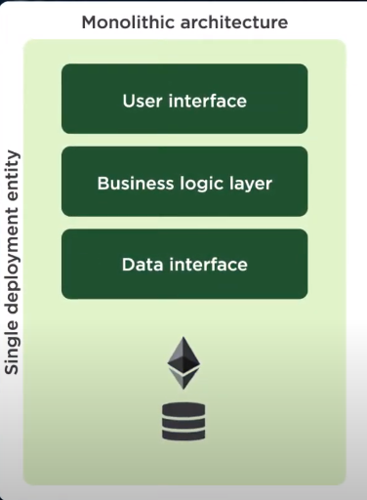
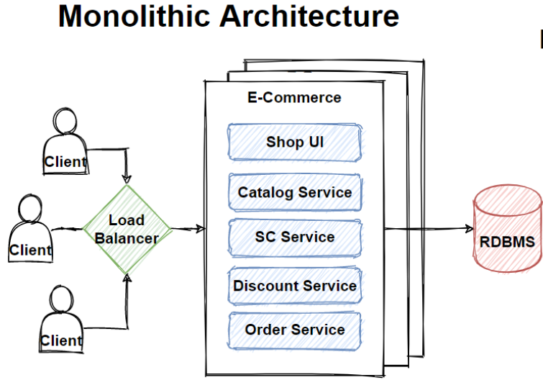
When it comes to legacy applications, we can say that most of legacy applications are mainly implemented as a monolithic architecture. If all the functionalities of a project exists in a single codebase, then that application is known as monolithic application.
In the monolith pattern, everything from user interface, business codes and database calls is included in the same codebase. All application concerns are contained in a single big deployment. Even the monolithic applications can design in different layers like presentation, business and data layer and then deploy that codebase as single jar/war file.

Slide 5
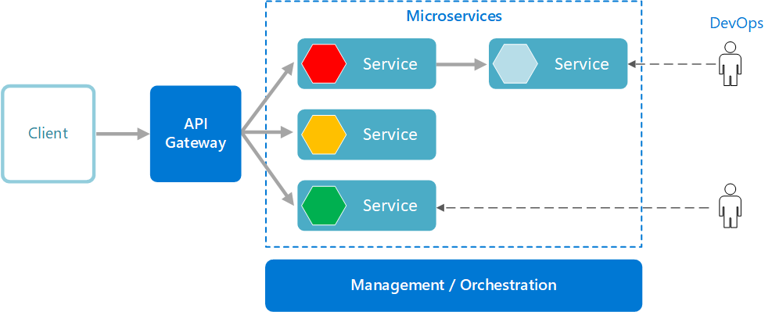
->Microservices are small, independent, and loosely coupled. A single small team of developers can write and maintain a service.
->Each service is a separate codebase, which can be managed by a small development team.
-> Services can be deployed independently. A team can update an existing service without rebuilding and redeploying the entire application.
->Services are responsible for persisting their own data or external state. This differs from the traditional model, where a separate data layer handles data persistence.

Slide 6
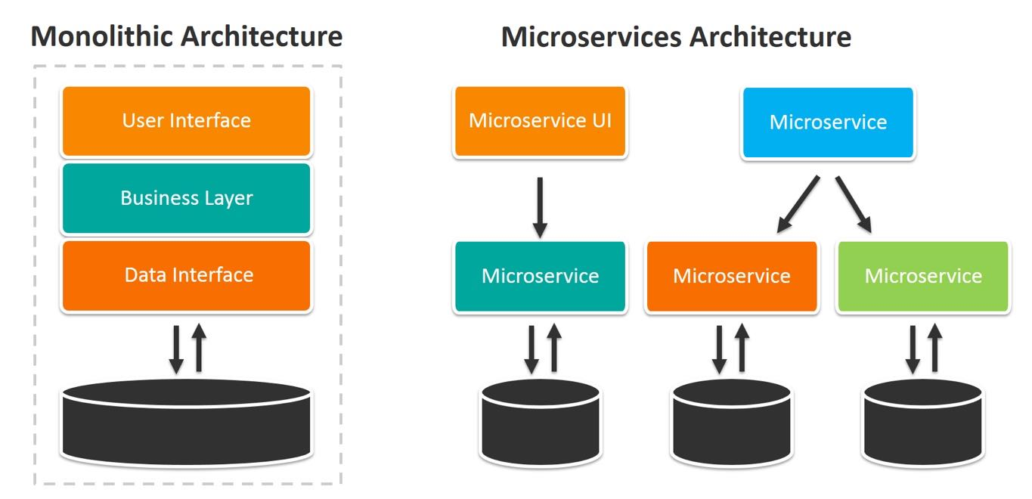

Slide 7
What is Cloud Computing?
Cloud computing is the delivery of online services (such as servers, databases, software) to users. With the help of cloud computing, storing data on local machines is not required. It helps you access data from a remote server. Moreover, it is also used to store and access data from anywhere across the world.
What is AWS?
Amazon web service is an online platform that provides scalable and cost-effective cloud computing solutions.
AWS is a broadly adopted cloud platform that offers several on-demand operations like compute power, database storage, content delivery, etc., to help corporates scale and grow.
How Does it Work?
That was all about what is AWS. Next, let’s have a look at the history.

Slide 8
Applications of AWS
1. Storage and Backup
One of the reasons why many businesses use AWS is because it offers multiple types of storage to choose from and is easily accessible as well. It can be used for storage and file indexing as well as to run critical business applications.
2. Websites
Businesses can host their websites on the AWS cloud, similar to other web applications.
3. Gaming
There is a lot of computing power needed to run gaming applications. AWS makes it easier to provide the best online gaming experience to gamers across the world.
4. Mobile, Web and Social Applications
A feature that separates AWS from other cloud services is its capability to launch and scale mobile, e-commerce, and SaaS applications. API-driven code on AWS can enable companies to build uncompromisingly scalable applications without requiring any OS and other systems.

Slide 9
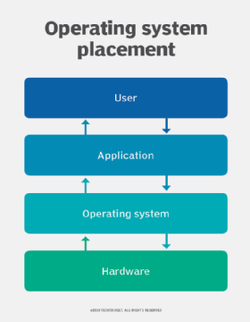
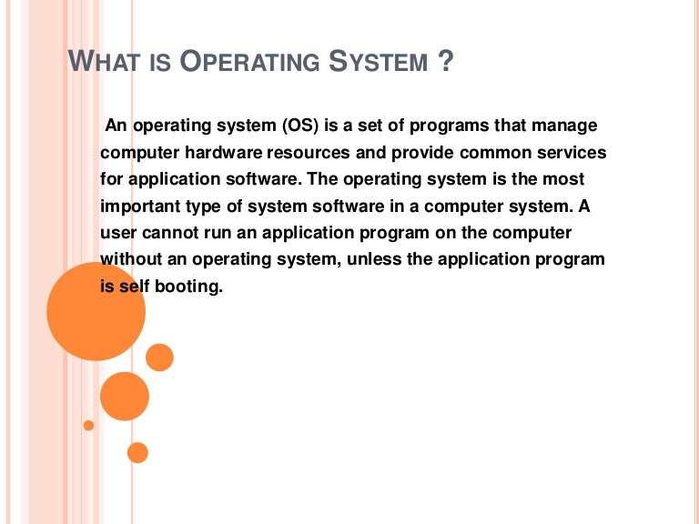
WHAT IS OPERATING SYSTEM

Slide 10
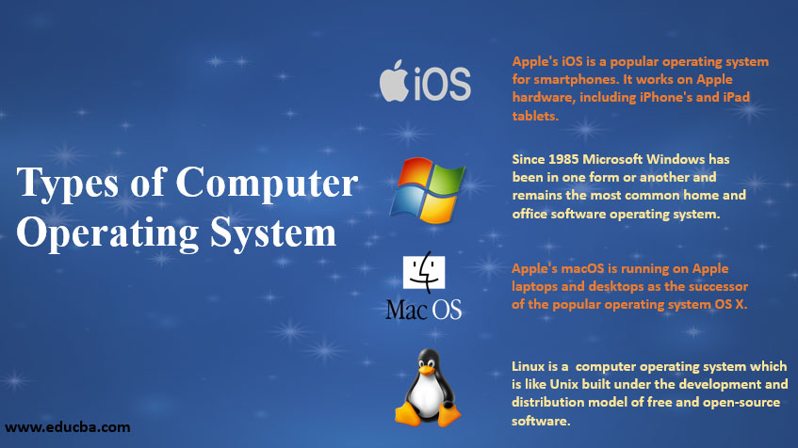
DIFFERENT TYPES OPERATING SYSTEM

Slide 11
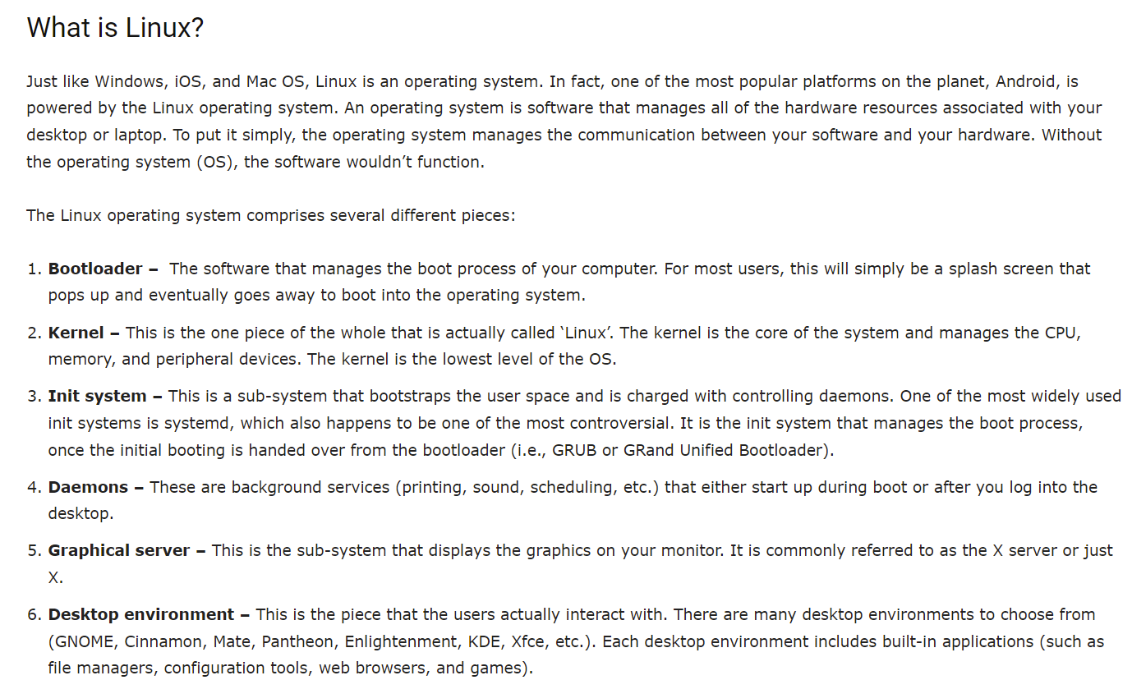
WHAT IS LINUX OPERATING SYSTEM

Slide 12
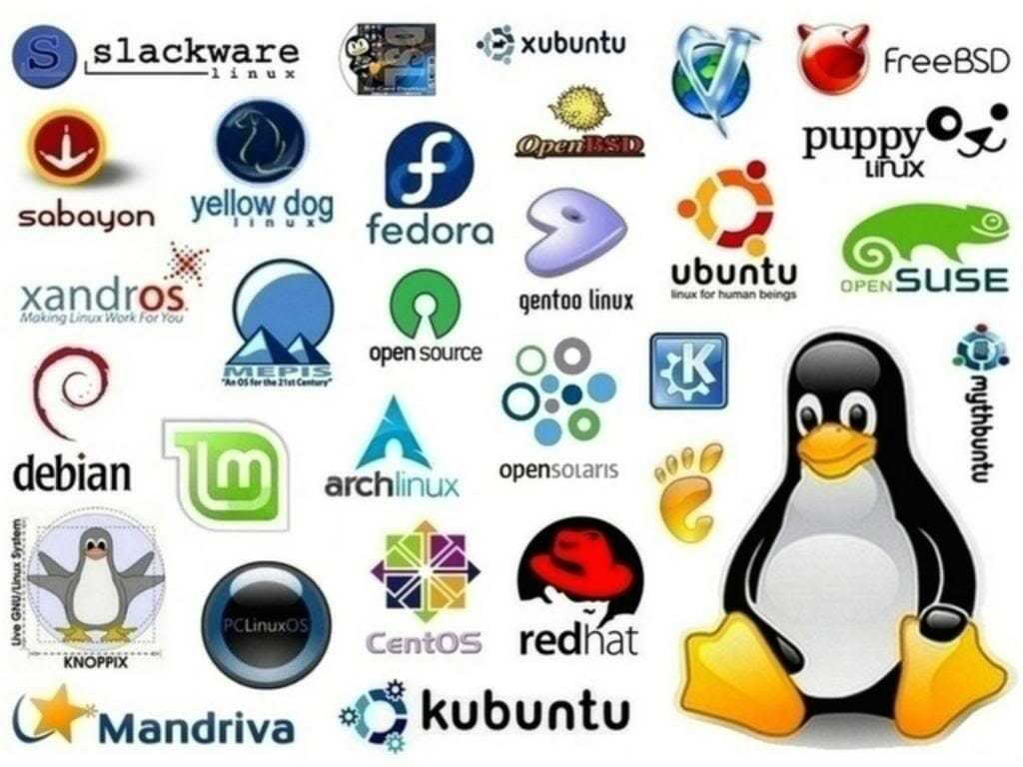
TYPES OF LINUX OPERATING SYSTEM

Slide 13
Elastic Compute Cloud(EC2)
Amazon Elastic Compute Cloud (Amazon EC2) provides scalable computing capacity in the Amazon Web Services (AWS) Cloud. Using Amazon EC2 eliminates your need to invest in hardware up front, so you can develop and deploy applications faster. You can use Amazon EC2 to launch as many or as few virtual servers as you need, configure security and networking, and manage storage. Amazon EC2 enables you to scale up or down to handle changes in requirements or spikes in popularity, reducing your need to forecast traffic.
Features of Amazon EC2
Amazon EC2 provides the following features:
Virtual computing environments, known as instances
Preconfigured templates for your instances, known as Amazon Machine Images (AMIs), that package the bits you need for your server (including the operating system and additional software)

Slide 14
Features of EC2
Secure login information for your instances using key pairs (AWS stores the public key, and you store the private key in a secure place)
Persistent storage volumes for your data using Amazon Elastic Block Store (Amazon EBS), known as Amazon EBS volumes
Multiple physical locations for your resources, such as instances and Amazon EBS volumes, known as Regions and Availability Zones
A firewall that enables you to specify the protocols, ports, and source IP ranges that can reach your instances using security groups
Static IPv4 addresses for dynamic cloud computing, known as Elastic IP addresses
Virtual networks you can create that are logically isolated from the rest of the AWS Cloud, and that you can optionally connect to your own network, known as virtual private clouds (VPCs)

Slide 15
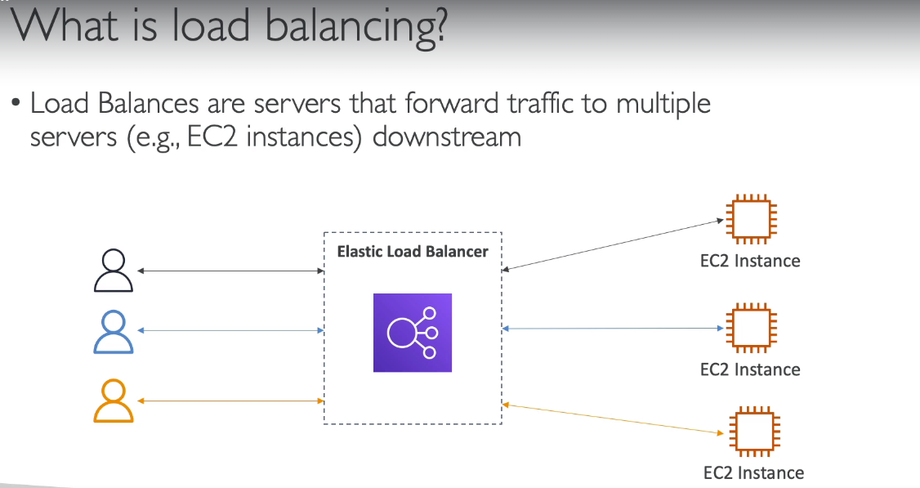

Slide 16
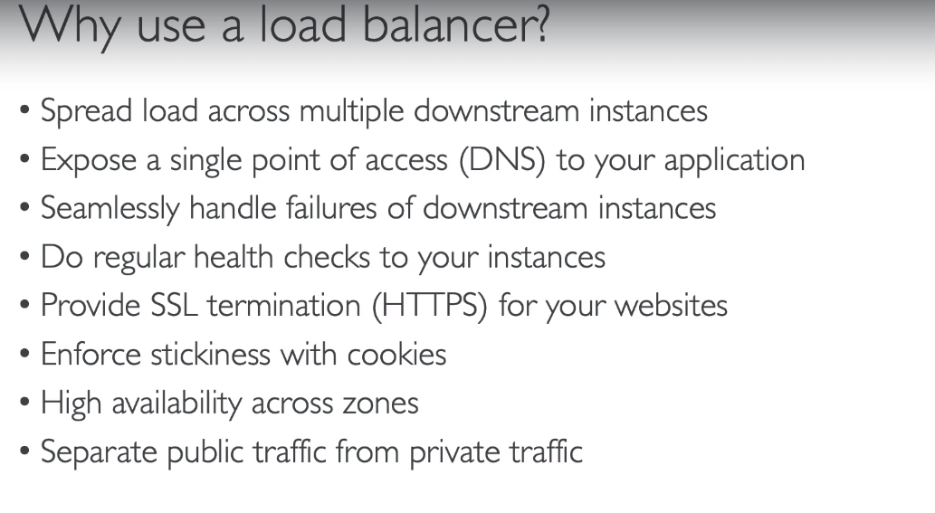

Slide 17
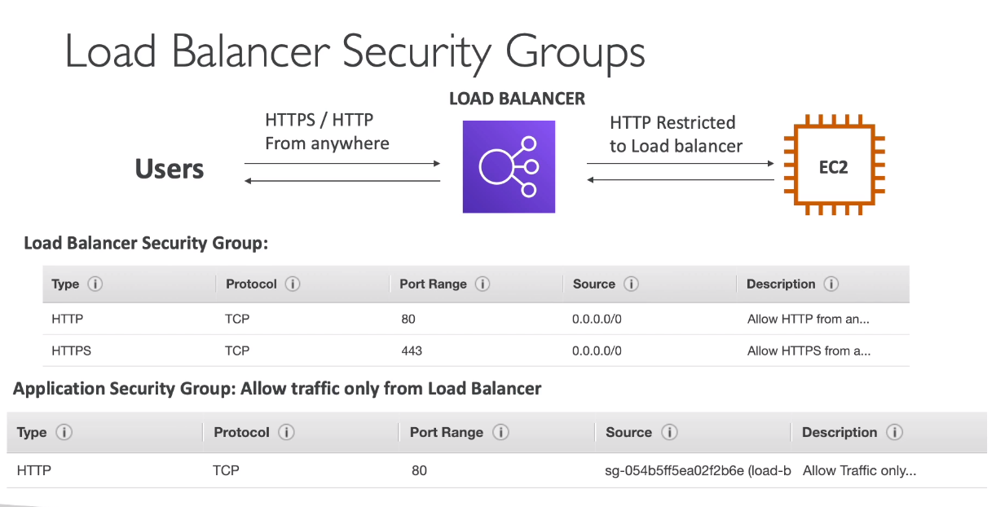

Slide 18
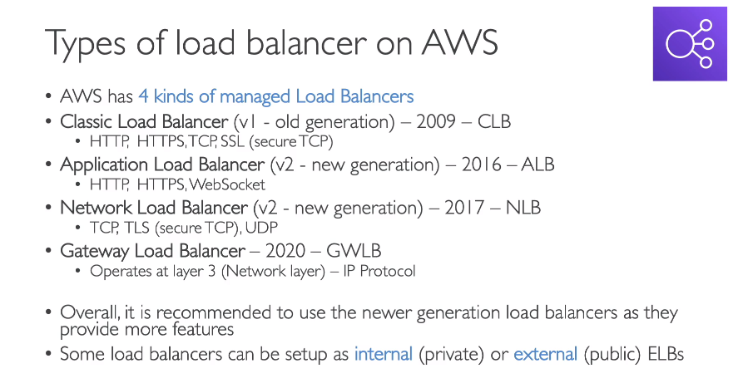

Slide 19
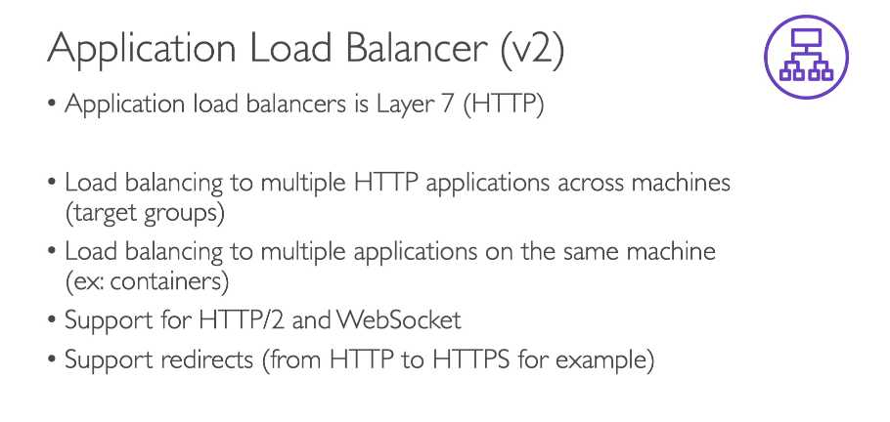

Slide 20
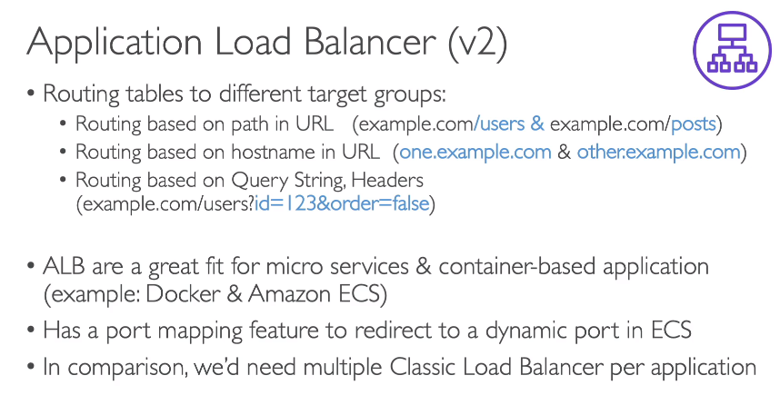

Slide 21
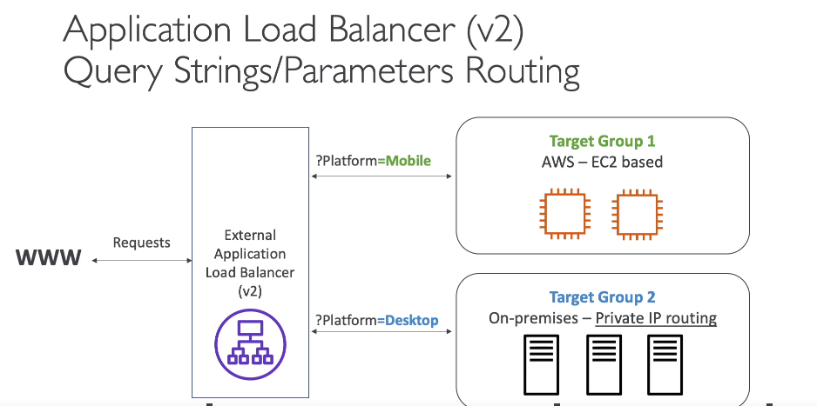

Slide 22
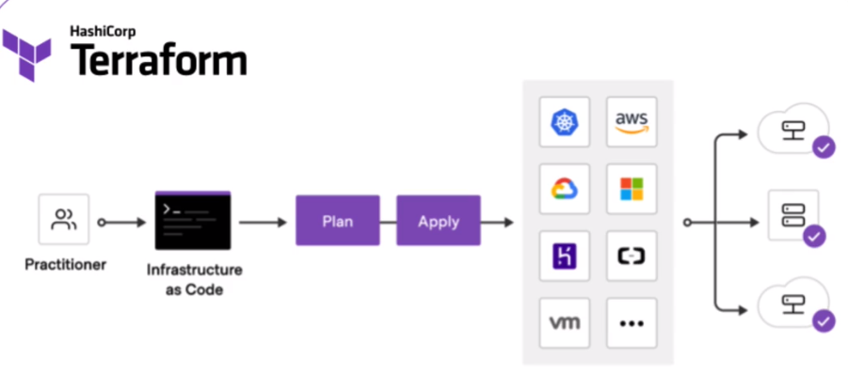

Slide 23
